Slide 1

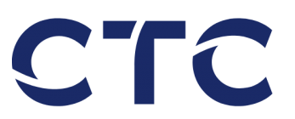
Fishing for Experience
Development of Solutions for Smart Factory
using Machine Learning Algorithms
Hamburg 02.09.2021

Slide 2
Table of Contents
1. | Problem Description / Motivation
2. | Main Tasks
3. | Prototype
 | - | Real Time Object Detection
 | - | Open Platform Communications (OPC)
 | - | Database
 | - | Dash Server
4. | Evaluation & Discussion
5. | Image Inpainting
6. | References

Slide 3
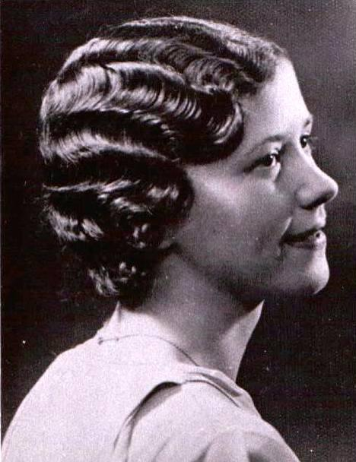
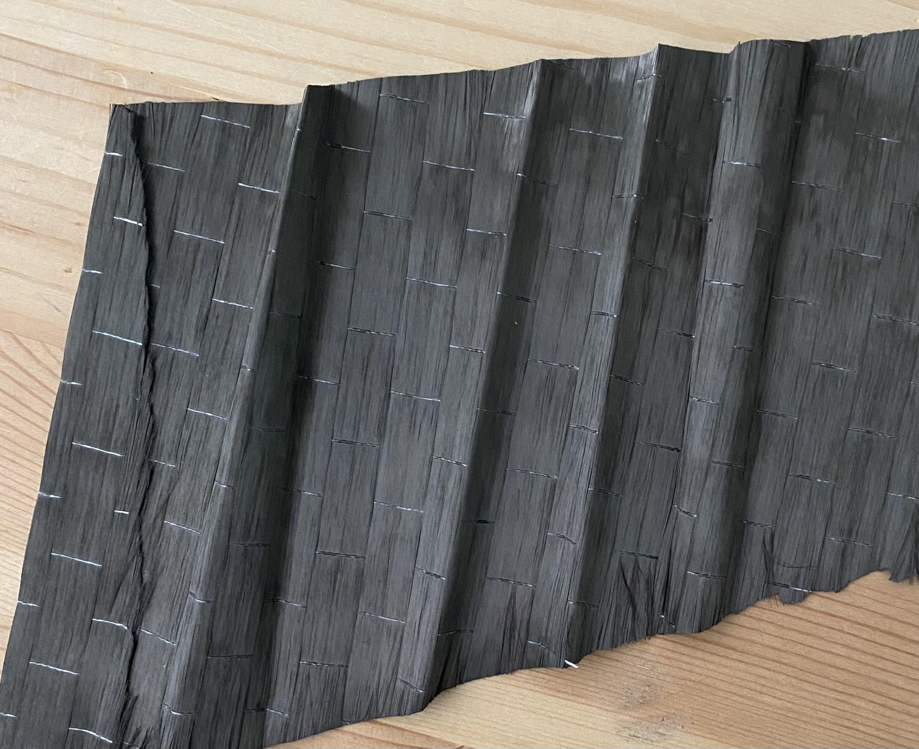
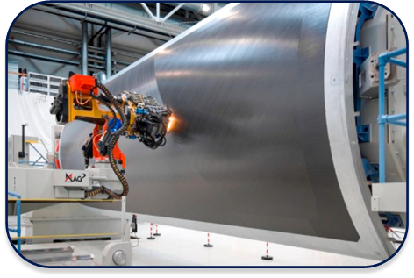
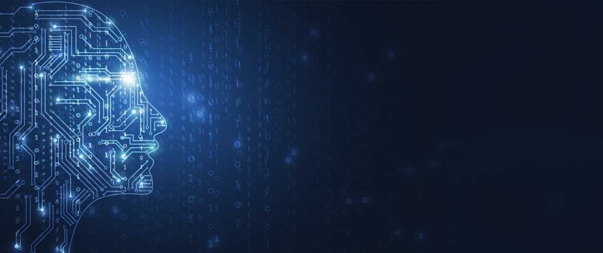
Problem Description / Motivation
The Problem of Quality & Progress Detection
Workers using conventional techniques to detect manufacturing defects
Composite material getting twisted, overlapped, creating bridged (waviness)
Proposed Solution
Real-Time Object Identification for Quality and Progress Detection using ML algorithms to increase production efficiency

Slide 4
Main Tasks
Detection of Manufacturing Defects using Machine Learning Algorithms
Real-Time Object Detection
Machine to Machine Communication
Custom Dataset
Generation
Training
Implementation
on Jetson Nano
Historian Server Access
Client Access
Dashboard Visualization
Store as time-series database
5

Slide 5
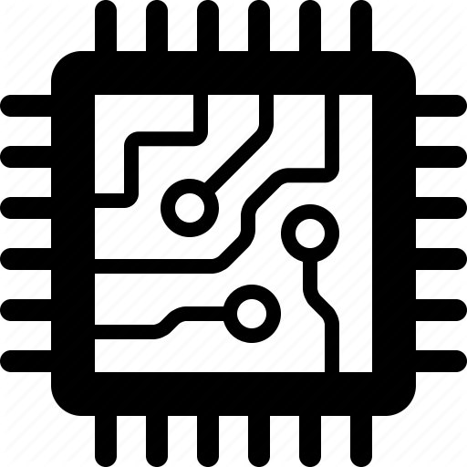

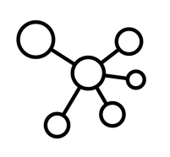

Prototype
YOLO
OPC
Server
some IoT devices
Database
Dash
Server
Webpage
= Docker Container
Jetson Nano with Linux and Docker
Notes:
Detection of CFRP in Camera and how to detect the Marcelling
Also, Discuss about potential hardware you may need
Object Detection
Transfer of Object detection values to another Machine
Object Inpainting

Slide 6
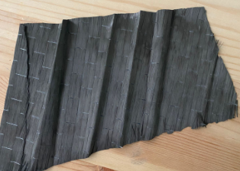
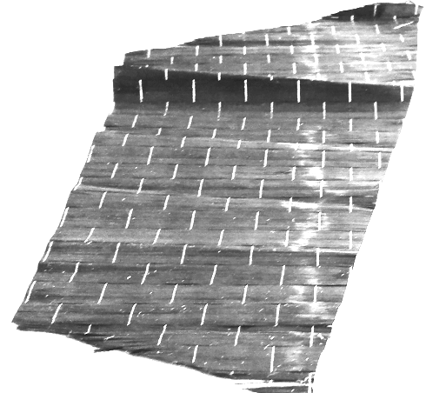
Proposed solution: YOLO based Object Detection
Custom Dataset Generation
How to generate the dataset:
Manually forming marcelling from small composite sheets
Accounting for backgrounds and lighting conditions
500 images taken
Manually labeling the dataset
Train using Google Colab GPU
3. Real Time Object Detection

Slide 7
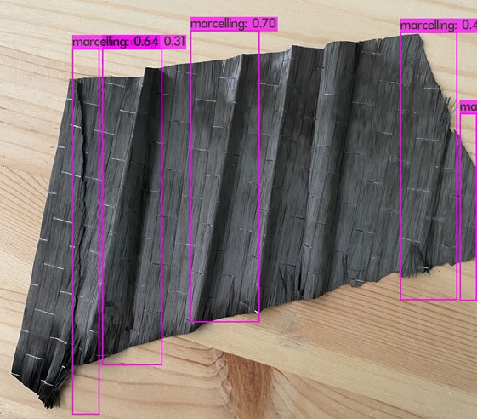

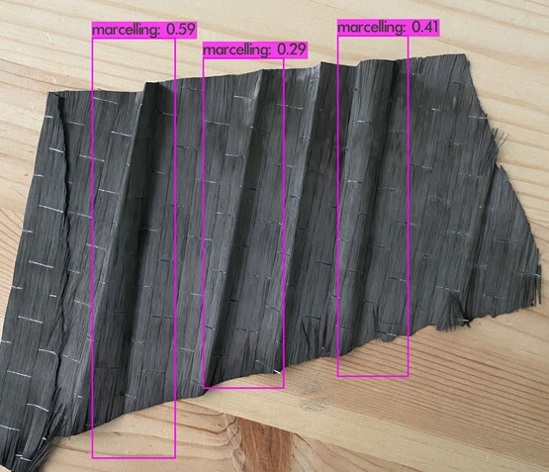

Proposed solution: YOLO based Object Detection
Object Detector Output
YOLO (You Only Look Once) algorithm using Darknet framework
Transfer Learning using pre-trained model on COCO dataset
YOLOv4- tiny
Faster, less complex
Real-time object detection
Testing the model on video stream and images
Retraining the model using more images, with various background, lighting etc.
YOLOv4 object detector outputs:
Detection frames (Bounding boxes)
Class name
Confidences and timestamps

Slide 8

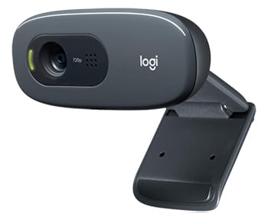


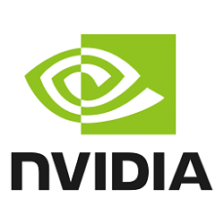
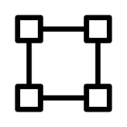
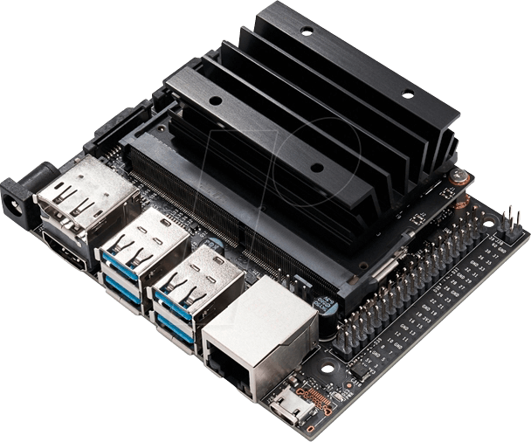
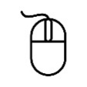
Proposed solution: YOLO based Object Detection
Real-Time Object Detection on Jetson Nano
Results:
Possible to detect “Marcelling” using YOLOv4-tiny object detection model
mAP ~ 78% at 6000 iterations
FPS up to 15 for detection
Webcam
Detection
Display
NVIDIA Jetson Nano

Slide 9
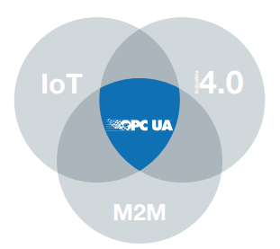
Open Platform Communication
Requirements: seamless connectivity
Challenges: Standardization, Compatibility
Solution: OPC UA (short for Open Platform Communications United Architecture)
Implementation: Historian database in Python and sqlite3 library
Advantages: Faster data access, secure and efficient communication
Notes:
Source: https://opcfoundation.org/wp-content/uploads/2016/05/OPC-UA-Interoperability-For-Industrie4-and-IoT-EN-v5.pdf
Industry 4.0 requires seamless connectivity between IoT(Internet of Things) and M2M(Machine to Machine communication)
Issues: Standardization of the information to be transferred (formats, content) and compatibility of the transmission channels is a major challenge
OPC UA (short for Open Platform Communications United Architecture)
It is a machine to machine communication standard for industrial automation developed by the OPC Foundation.
Features:
Industry 4.0 requires seamless connectivity between IoT(Internet of Things) and M2M(Machine to Machine communication)
Challenges : Standardization, Compatibility
OPC UA (short for Open Platform Communications United Architecture)
WHAT? machine to machine communication standard
how?Implemented as a historian database in python using opcua and sqlite3 library

Slide 10
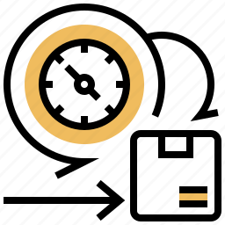


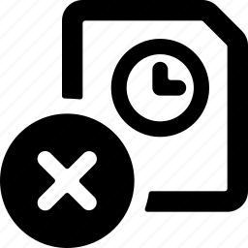

OPC UA Server Implementation: Database
Create Database
Add Timestamp
Retrieve latest Timestamp
Delete older Timestamps
0
time
Notes:
No admn
An SQLite database is limited in size to 281 terabytes (2⁴⁸ bytes, 256 tibibytes). And even if it could handle larger databases, SQLite stores the entire database in a single disk file and many filesystems limit the maximum size of files to something less than this.

Slide 11
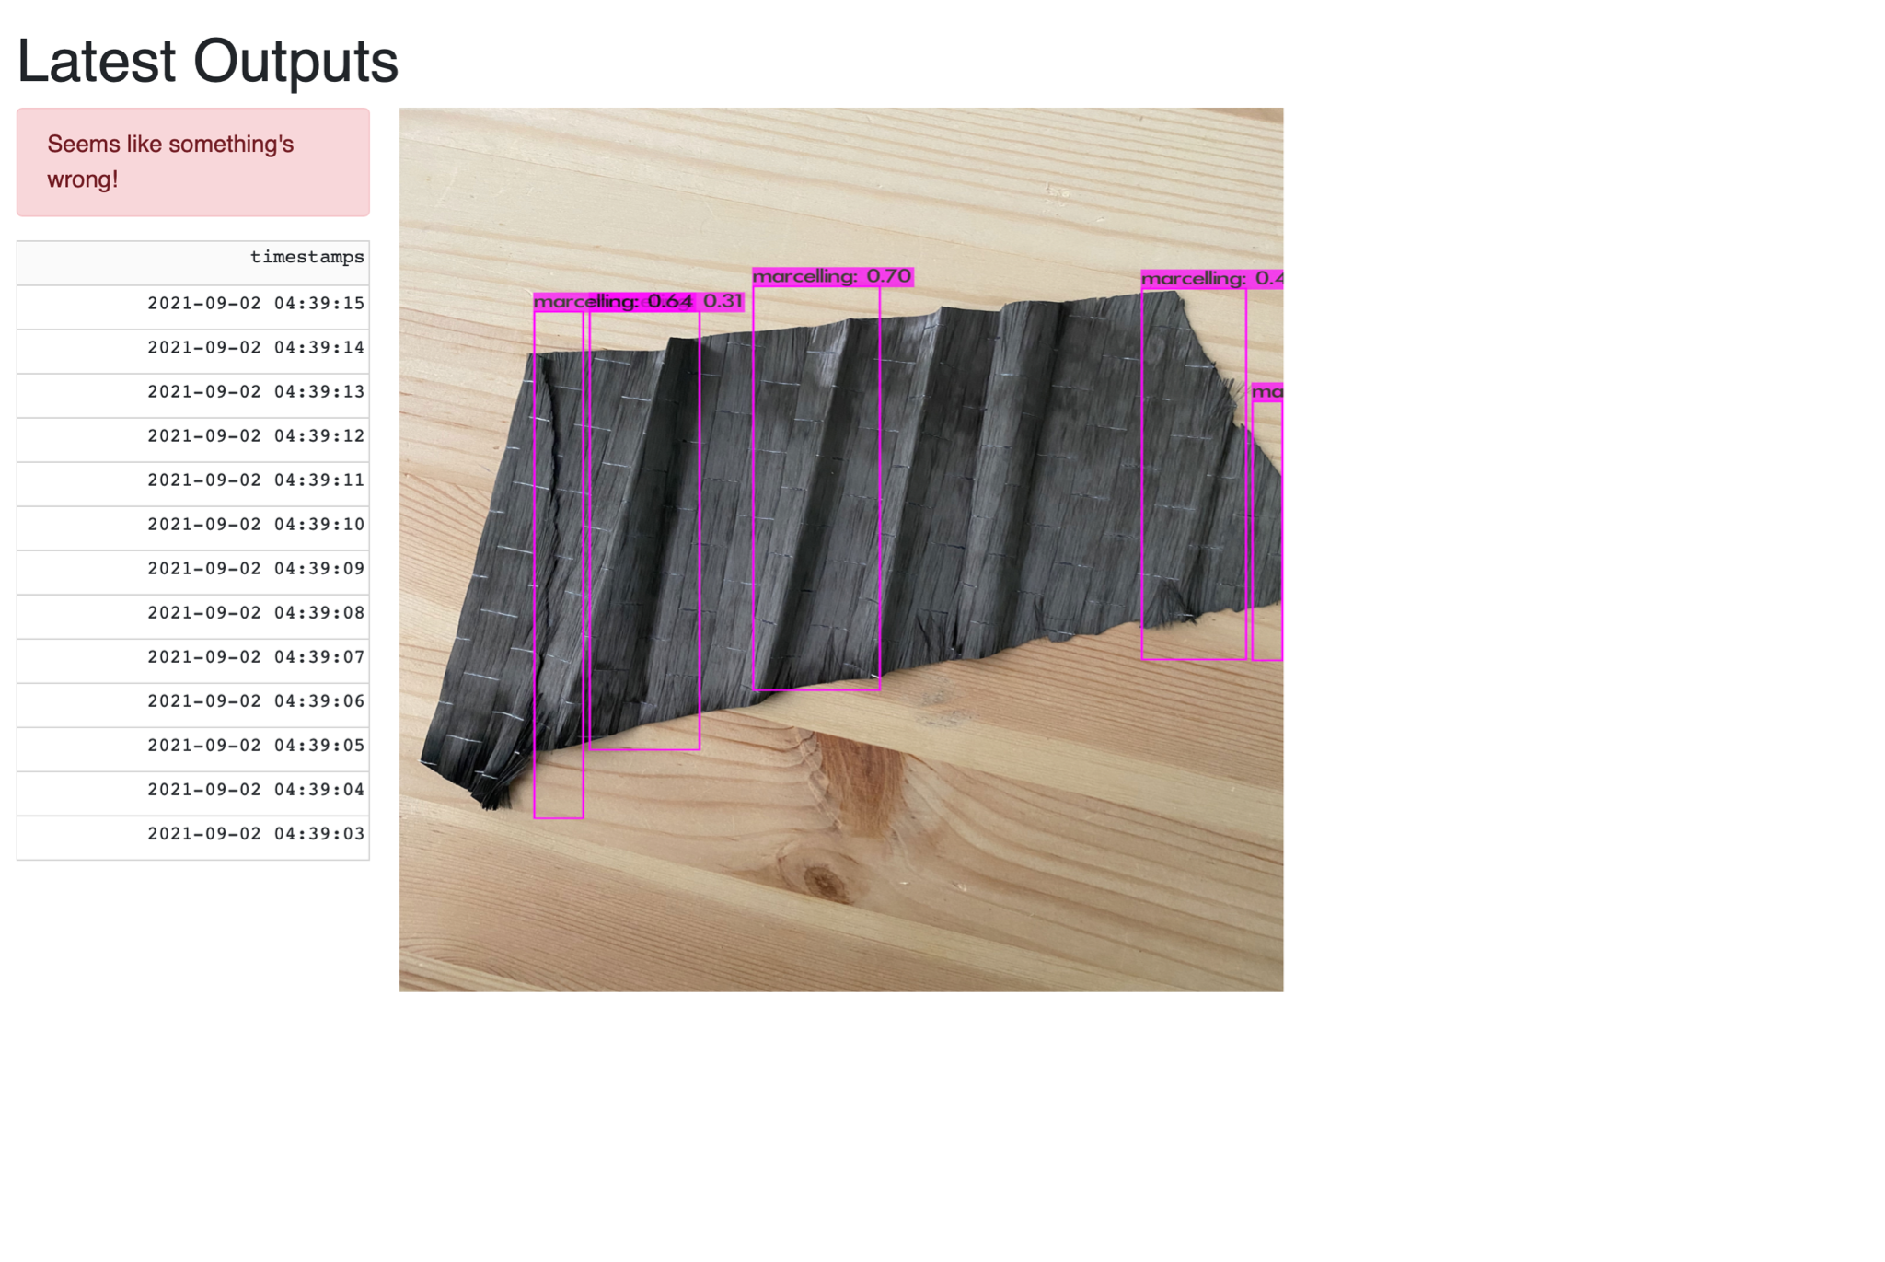
Dash Server

Slide 12
Evaluation & Discussion
Conclusions from Object Detection segment:
Need better hardware for faster implementation (23fps)
Possible angle and lighting bias is present (diversify even more)
Need for 4 to 5x more images for training on an actual dataset in company environment
Docker implementation
Docker:
use docker compose to configure docker setup easier
Dash WebApp:
Images are loaded, better: showa live stream
switch between image-history
OPC UA
Apply security mechanisms to communication between machine, OPC UA server and client

Slide 13
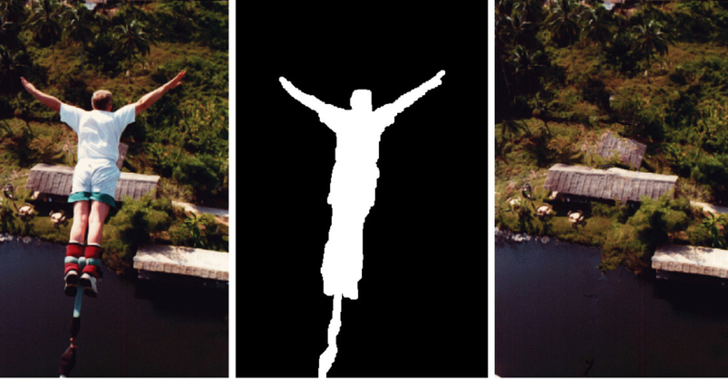
Inpainting: Table of Contents
Motivation
Problem Description
Our Approach
Proposed Solution
Results
Challenges
Conclusion
Creative Commons Attribution 2.0 Generic
Table of Contents

Slide 14
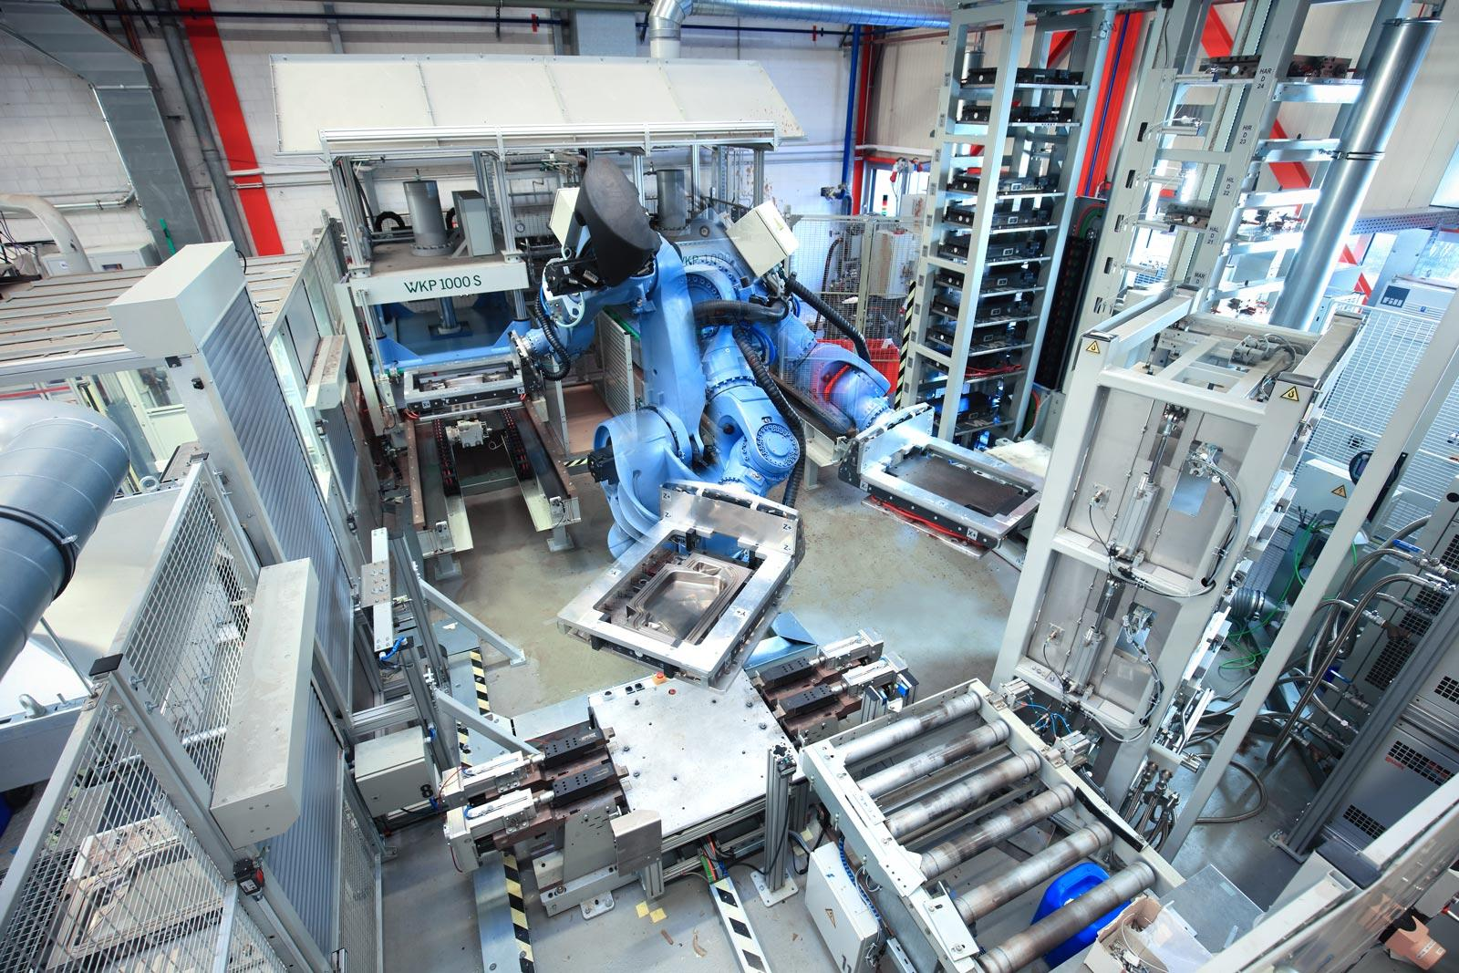
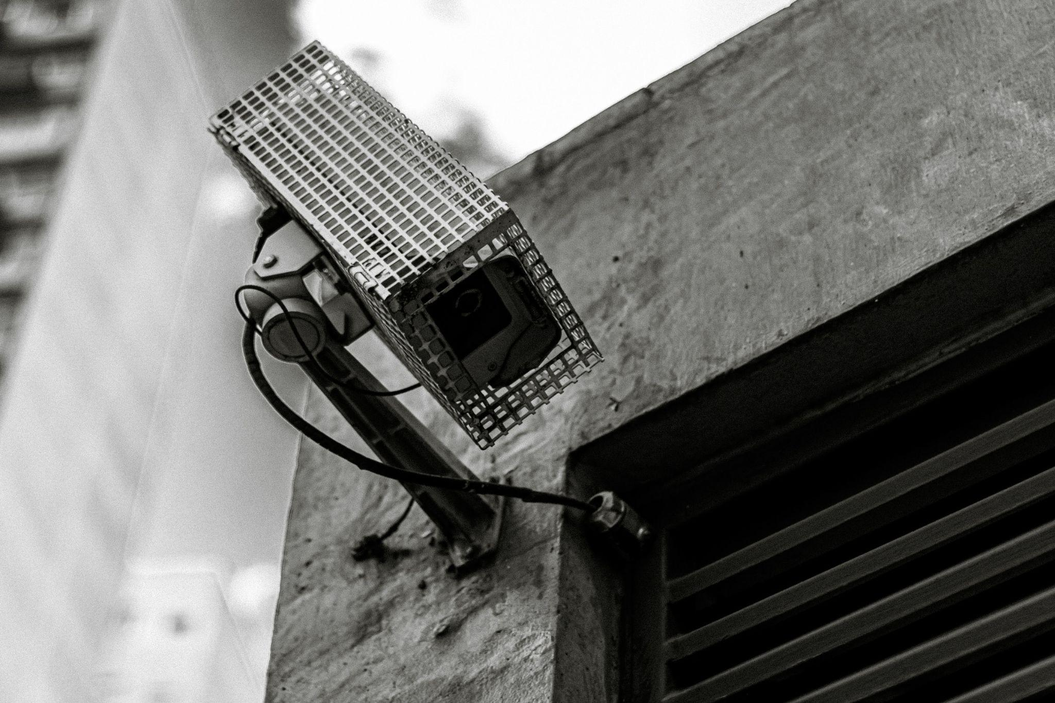
Inpainting: Motivation
Smart Factory
Privacy issue
Image Inpainting
Requires many cameras on the CTC work area
It is not allowed to monitor workers
manipulate video stream such that workers become invisible
ctc-composites.com
Creative Commons Zero
Notes:
at this point there is only one camera to detect defects but in the future there might be many cameras around to automate several processes

Slide 15

Inpainting: Problem Description
apply background inpainting
to fill in masked area
detect objects (i.e. workers)
mask workers
Video: stream of frames
for each frame

Slide 16
Approach
Manual Image Inpainting
Segmentation and Masking using deeplab
Applying 3 different approaches and comparing results

Slide 17
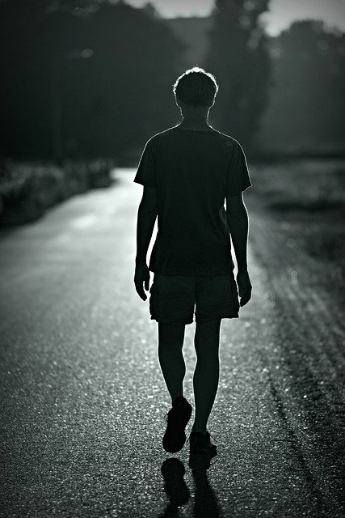
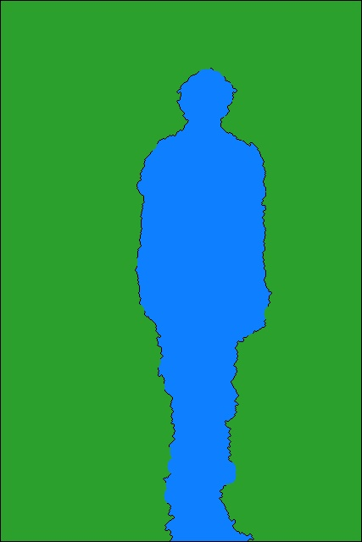
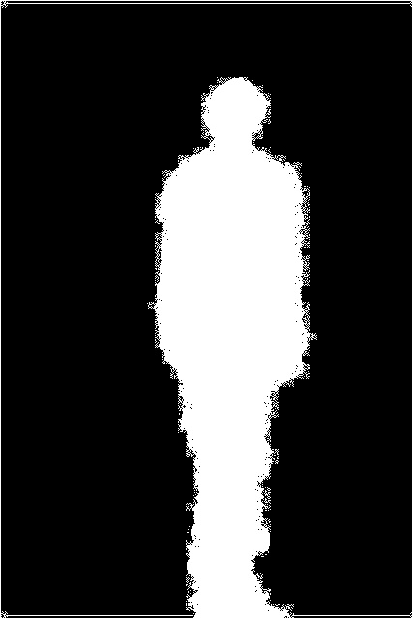
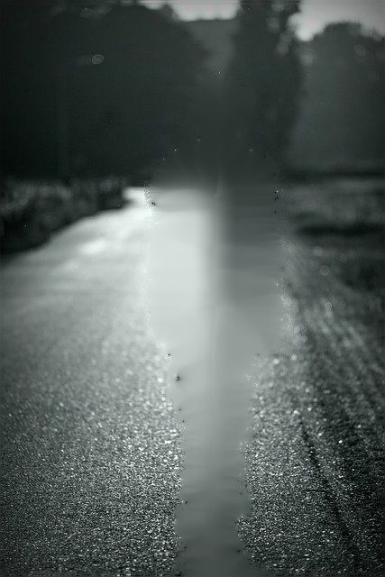
Manual Image Inpainting
01
Segmenting
02
Masking
03
Inpainting

Slide 18
Inpainting: Proposed Solution
Video stream divided into frames
Detecting people:
DeepLab
pre-trained model using COCO dataset
Masking people:
Semantic Segmentation
pre-trained DeepLab model
two classes
Video Inpainting
Classical approach (TELEA)
STTN
Flow guided video completion using GAN

Slide 19
Device configuration
Processor - Intel(R) Core(TM) i7-7700HQ CPU @ 2.80GHz 2.81 GHz
RAM - 16,0 GB
Graphics - NVIDIA geForce gtx 1050 ti

Slide 20
Segmentation and Masking using DeepLab

Slide 21
Applying 3 different approaches and comparing results

Slide 22
OpenCV inbuilt function - TELEA

Slide 23
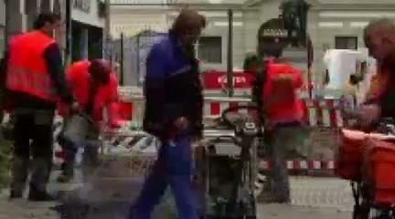
Spacial Temporal Transformer Network(STTN)

Slide 24
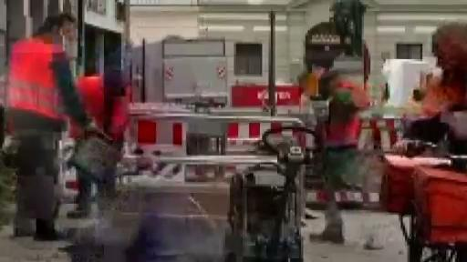
Flow guided video completion using GAN

Slide 25
Inpainting: Challenges we faced
relatively new research area
computational speed - nearly 15 minutes for the neural network based approaches
transferring algorithms for still images to videos

Slide 26
Inpainting: Conclusion
Segmenting person and masking is a significant intermediate process and requires deep learning approaches
OpenCV-TELEA showed best results and consumed less computational time compared to other methods
the tested neural network based methods are not matured enough for live video inpainting

Slide 27
References
Object Detection
YOLO Docker implementation: https://medium.com/analytics-vidhya/object-detection-using-yolo-v3-and-deploying-it-on-docker-and-minikube-c1192e81ae7a
Source page for YOLO https://pjreddie.com/darknet/yolo/
Jing J, Zhuo D, Zhang H, Liang Y, Zheng M. Fabric defect detection using the improved YOLOv3 model. Journal of Engineered Fibers and Fabrics. January 2020. doi:10.1177/1558925020908268
Sacco, C.(2019). Machine Learning Methods for Rapid Inspection of Automated Fiber Placement Manufactured Composite Structures. (Master's thesis). Retrieved from https://scholarcommons.sc.edu/etd/5475
OPC UA Communication
https://opcfoundation.org/wp-content/uploads/2016/05/OPC-UA-Interoperability-For-Industrie4-and-IoT-EN-v5.pdf
https://github.com/FreeOpcUa/python-opcua
https://python-opcua.readthedocs.io/en/latest/
https://docs.python.org/3/library/sqlite3.html
Inpainting
Watershed algorithm for manual segmentation - https://docs.opencv.org/4.5.1/d3/db4/tutorial_py_watershed.html
TELEA function for Image Inpainting - https://docs.opencv.org/4.5.2/d7/d8b/group__photo__inpaint.html
Deeplab for semantic segmentation - https://github.com/tensorflow/models/tree/master/research/deeplab
Learning Joint Spatial-Temporal Transformations for Video Inpainting - https://github.com/researchmm/STTN
Flow guided video completion - https://github.com/vt-vl-lab/FGVC
X.X Abschnitt und Titel der aktuellen Folie zusammengefasst
Notes:
https://github.com/FreeOpcUa/python-opcua

Slide 28
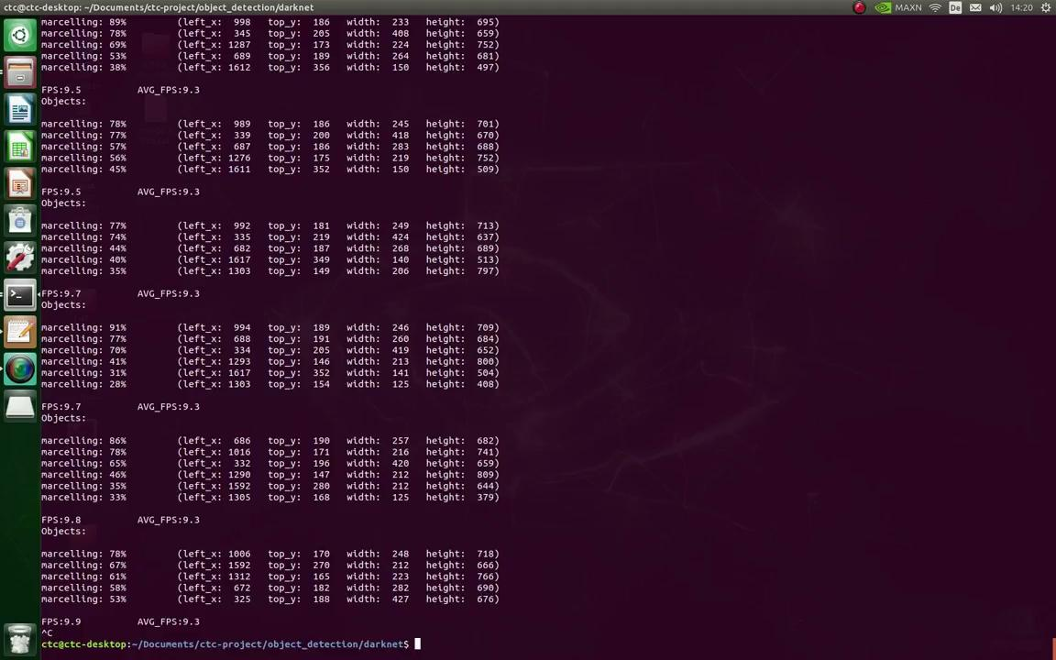
Demo

